Slide 1
Limitations of Behavioral Economics

Slide 2
Limitations of Behavioral Economics
The study of behaviors from economics began after the WW2.
Researchers found out that most people are rational.
It lead to the theorisation of the intuitive statistician program:
This intuitive statistician program found enough correspondence between people’s judgments and the predictions of normative models (i.e., rules from probability theory and statistics) to conclude that the models could provide a basis for theories of how people reason about probabilities. Indeed, in a 1967 review of more than 160 experiments, psychologists Cameron Peterson and Lee Roy Beach concluded that people can make reasonably accurate inferences about probabilities. People, the researchers argued, are intuitive statisticians.

Slide 3
However, in the 70’s Tversky and Kahneman, with the heuristics and biases program, postulated that people are irrational, with cognitive limitations.
How can we resolve this paradox?
By taking into account that Experimental methods are not neutral tools

Slide 4
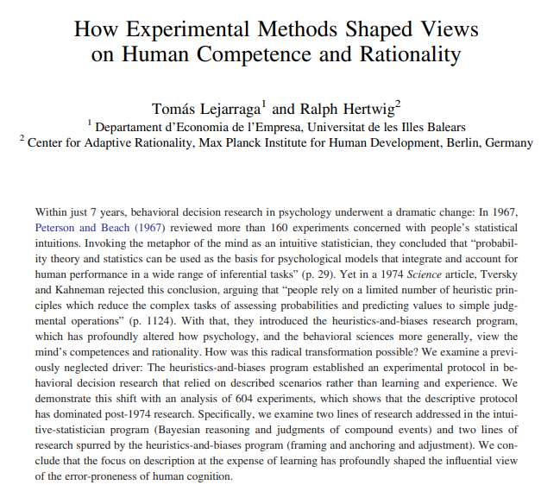
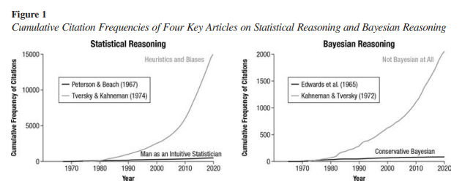
Experimental methods are not neutral tools

Slide 5
Learning and feedback
In the 1960s, researchers used an experiential protocol that allowed people to learn probabilities from direct experience. Usually, people could practice, sample information sequentially, and adjust responses continually with feedback. | But Tversky and Kahneman replaced this experiential protocol with a descriptive one. Their experiments presented people with descriptive scenarios and word problems and tended to ask for a one-off estimate or judgment. Participants in their studies had little opportunity to practice or learn from feedback.

Slide 6
Real situation versus description
Simon (1979, 1989) urged economists to move away from as-if expected utility models and study how people actually make decisions in realistic situations of uncertainty as opposed to under risk.
One example from Bayesian reasoning:
A disease has a base rate of .1, and a test is performed that has a hit rate of .9 and a false positive rate of .1 (the conditional probability of a positive test given no disease). What is the probability that a random person with a positive test result actually has the disease?
Among every 100 people, 10 are expected to have a disease. Among those 10, nine are expected to correctly test positive. Among the 90 people without the disease, nine are expected to falsely test positive. What proportion of those who test positive actually have the disease?

Slide 7
A disease has a base rate of .1, and a test is performed that has a hit rate of .9 and a false positive rate of .1 (the conditional probability of a positive test given no disease). What is the probability that a random person with a positive test result actually has the disease?
Among every 100 people, 10 are expected to have a disease. Among those 10, nine are expected to correctly test positive. Among the 90 people without the disease, nine are expected to falsely test positive. What proportion of those who test positive actually have the disease?
(0,1*0,9)/[(0,1*0,9)+(0,9*0,1)] = 0,5
9/(9+9)=0,5
160 Gynecologists
21% guessed right
87% guessed right
De-biasing effect: humans can learn Bayesian inference quickly if the information is presented in natural frequencies.

Slide 8
Why was the heuristics and biases program so popular ?
Minimal setup and implementation cost leading to cheaper data collection
A tendency for researchers to like these theories
A possibility for researchers to advance their career
A demand from policy-makers
A Bias of Bias

Slide 9
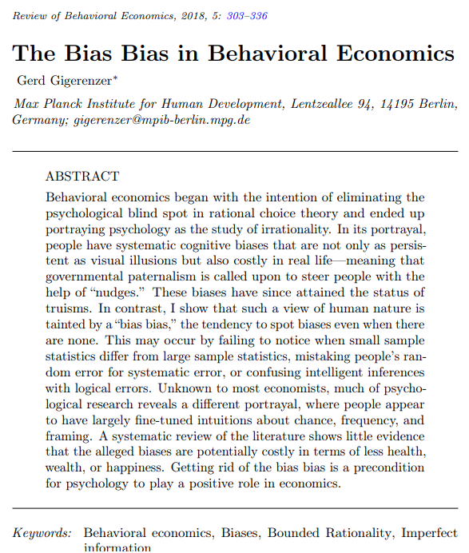
The Bias of Bias
Lack of rationality.
Experiments have shown that people’s intuitions are systematically biased.
2. Stubbornness.
Like visual illusions, biases are persistent and hardly corrigible by education.
3. Substantial costs.
Biases may incur substantial welfare-relevant costs such as lower wealth, health, or happiness.
4. Biases justify governmental paternalism.
To protect people from their biases, governments should “nudge” the public toward better behavior.

Slide 10
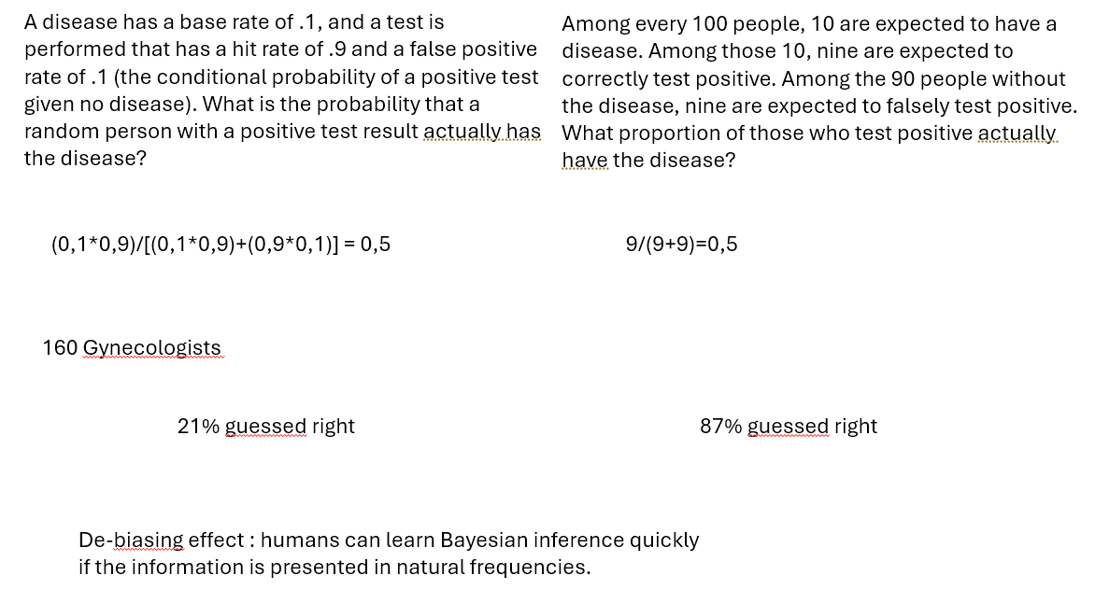
Lack of rationality.

Slide 11
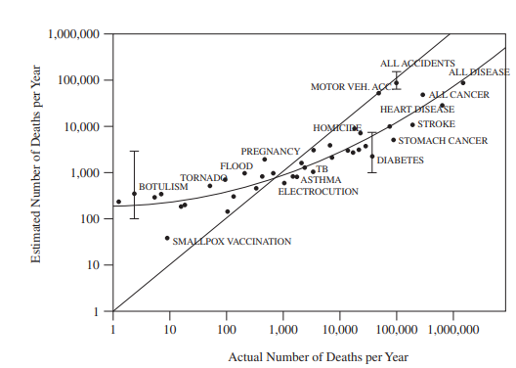
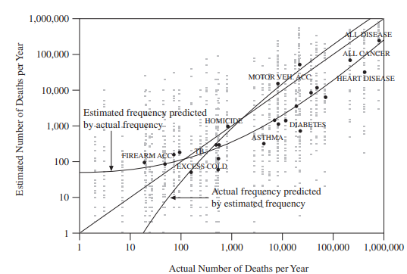
Lack of rationality.
Regression to the mean
Notes:
Left Lichtenstein 1978 – overestimation then underestimation based on frequency
Right Hertwig 2005 – underestimation then overestimation if based on %

Slide 12
Lack of rationality. Remember this problem?
There is an impending pandemic threatening to kill 600 people and you have two options: (A) Save 200 people (B) Save 600 people with 1/3 chance and save 0 people with 2/3 chance.
The same disease is threatening society, but you are given two different options this time: (C) Kill 400 people (D) Kill 0 people with 1/3 chance and kill 600 people with 2/3 chance.
AND NOT KILL 200 PEOPLE
AND NOT SAVE 400 PEOPLE
We need the full information for both programs

Slide 13
Lack of rationality.
Further studies indicated that many people notice the asymmetry and infer that the incomplete option means that at least 200 people are saved because, unlike in Program B, the information for how many will not be saved is not provided (Mandel, 2014).
Under this inference, Program A guarantees that 200 or more people are saved, as opposed to exactly 200. Thus, people’s judgments appear to have nothing to do with unstable preferences or with positive versus negative framing.
The incompleteness of Program A alone drives the entire effect. When supplied with incomplete information, people have to make intelligent inferences. Doing so is not a bias.

Slide 14
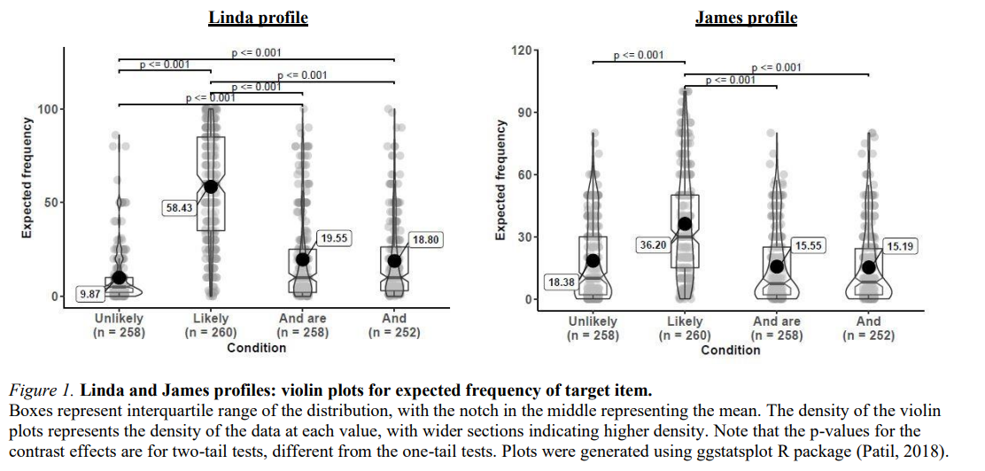
Lack of rationality. Conjunction bias is frame dependent
Notes:
Chandrashekar (2021)

Slide 15
Stubbornness.
Like visual illusions, biases are persistent and hardly corrigible by education.
NOT TRUE
Visual illusions are not a sign of irrationality, but a byproduct of an intelligent brain that makes “unconscious inferences from two-dimensional retinal images to a three-dimensional world.
Researchers in vision consider our visual system a marvel of unconscious intelligence that manages to infer three-dimensional objects from a two-dimensional retinal picture
In Shepard’s (1990) words, “to fool a visual system that has a full binocular and freely mobile view of a wel lilluminated scene is next to impossible”. Thus, in psychology, the visual system is seen more as a genius than a fool in making intelligent inferences, and inferences, after all, are necessary for making sense of the images on the retina.

Slide 16
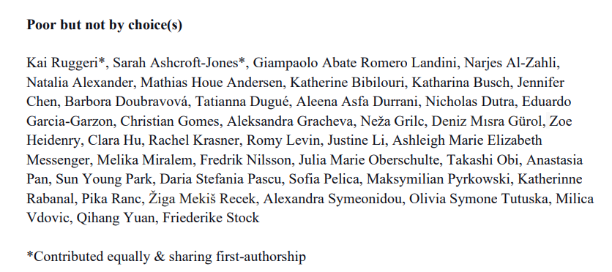
Substantial costs.
Biases may incur substantial welfare-relevant costs such as lower wealth, health, or happiness.
27 countries, 5000 participants
Test between low-income people and positive deviants
Positive deviants: individuals that had overcome financial disadvantages as children

Slide 17
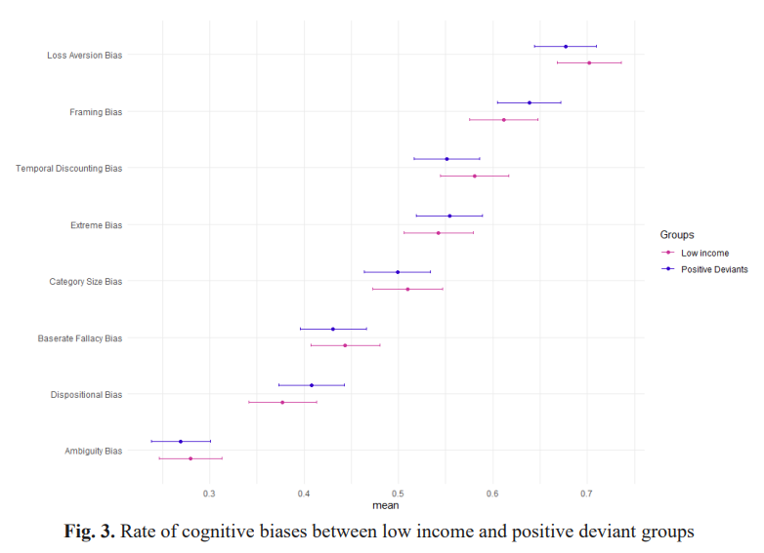

Slide 18
The Bias of Bias
Lack of rationality.
Experiments have shown that people’s intuitions are systematically biased.
2. Stubbornness.
Like visual illusions, biases are persistent and hardly corrigible by education.
3. Substantial costs.
Biases may incur substantial welfare-relevant costs such as lower wealth, health, or happiness.
4. Biases justify governmental paternalism.
To protect people from their biases, governments should “nudge” the public toward better behavior.

Slide 19
Developmental psychologist and APS President Alison Gopnik once asked, “Why are grown-ups often so stupid about probabilities when even babies and chimps can be so smart?” (Gutíerrez, 2014).
Answer : the experimental methods to study babies and adults are different and lead to different conclusions
The Bias Bias: The tendency to see systematic biases in behavior even when there is only unsystematic error or no verifiable error at all.

Slide 20
Concepts to remember
intuitive statistician program Versus heuristics and biases program
The heuristics and biases program use descriptives scenarios – one shot without learning possibilities. In some cases, the scenarios are non-naturals.
It lead to the de-biasing effect:
We can modify the framing or make people learn to avoid the bias. Then we cannot be so sure about the existence of a « bias »
It lead to the question : is there a bias of bias?
Next (and last) lecture on Paternalism, Nudges, and current direction of behavioral economics.

Slide 21
The Bias of Bias
Lack of rationality.
Experiments have shown that people’s intuitions are systematically biased.
2. Stubbornness.
Like visual illusions, biases are persistent and hardly corrigible by education.
3. Substantial costs.
Biases may incur substantial welfare-relevant costs such as lower wealth, health, or happiness.
4. Biases justify governmental paternalism.
To protect people from their biases, governments should “nudge” the public toward better behavior.

Slide 22
Behavioral policies : Governmental paternalism
To protect people from their biases, governments should “nudge” the public toward better behavior.

Slide 23
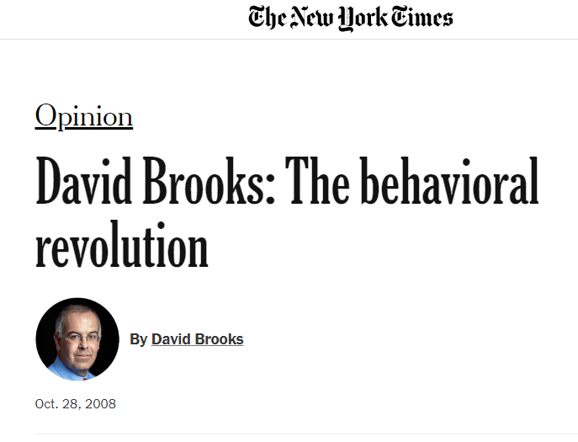
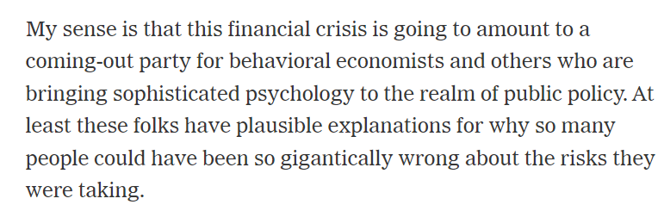

Slide 24
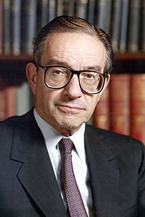
Alan Greenspan
“I made a mistake in presuming that the self-interests of organizations, specifically banks and others, were such as that they were best capable of protecting their own shareholders and their equity in the firms.”
Notes:
The former chairman of the Federal Reserve, close to Reagan (conservative)

Slide 25
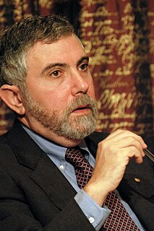
Paul Krugman
“[Economists] need to abandon the neat but wrong solution of assuming that everyone is rational and markets work perfectly. The vision that emerges as the profession rethinks its foundations may not be all that clear; it certainly won’t be neat; but we can hope that it will have the virtue of being at least partly right. ”
Notes:
the Nobel laureate and liberal economic commentator

Slide 26
Behavioral Policy
Economic policy informed by behavioral theory.
Since behavioral (like neoclassical) economists take their central normative concern to be welfare, and perhaps its distribution, this work is often discussed under the heading of behavioral welfare economics.

Slide 27
Libertarian Paternalism
Libertarian paternalism: the thesis that it is legitimate to help people make better decisions themselves, by their own lights, if it is possible to do so without interfering with their liberty or autonomy.
Also soft, light, or asymmetric paternalism.
Notes:
Provides a sufficient condition for intervening.

Slide 28
Libertarian
Libertarian paternalism is paternalistic in the sense that it aims to make people better off. — It aims to enhance the welfare of the people who are targeted by the policy.
Libertarian paternalism is libertarian in the sense that it tries to do so in a manner that respects their liberty and autonomy. — It eschews dictatorial solutions.
Notes:
Don’t endorse the terminology

Slide 29
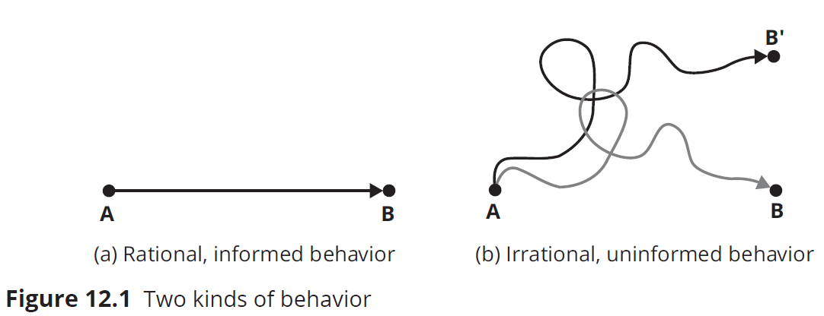
Two Kinds of Behavior

Slide 30
A Nudge
A nudge is an intervention on the choice architecture, such that the following criteria are satisfied:
Aims to help people make better decisions themselves, rather than making decisions for them
Imposes trivial costs on people
No, or trivial, effects on people who are already rational and informed
Has a non-trivial and potentially large beneficial effect on people who are not already rational or informed (by their own lights)

Slide 31
Examples of Nudges
Default options are options that are made default unless the decision-maker makes an active choice to opt in or out.
Example: Social-media privacy settings are often “public” unless you change them.
Cooling-off periods are periods of time following a decision in which decision-makers can reverse their choice to counteract impulsive decisions.
The Save More Tomorrow (SMarT) Program encourages workers to save more for retirement by giving them the option of committing in advance to allocating a portion of their future raises toward savings.

Slide 32
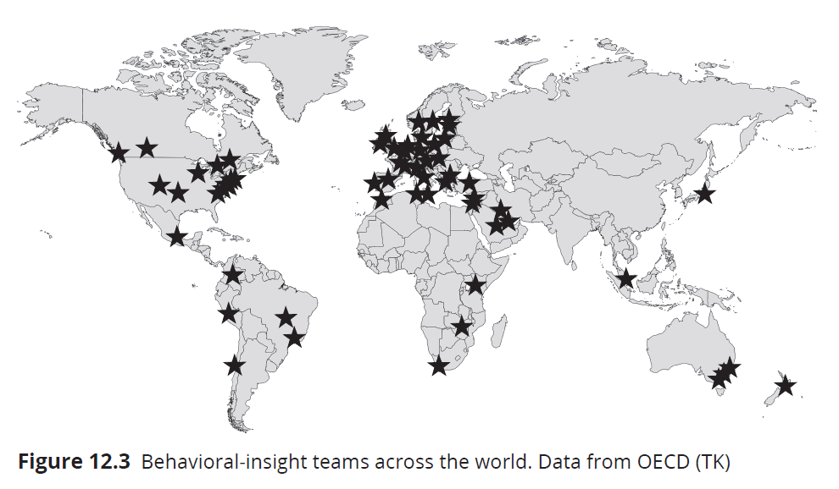
BI Teams Worldwide

Slide 33
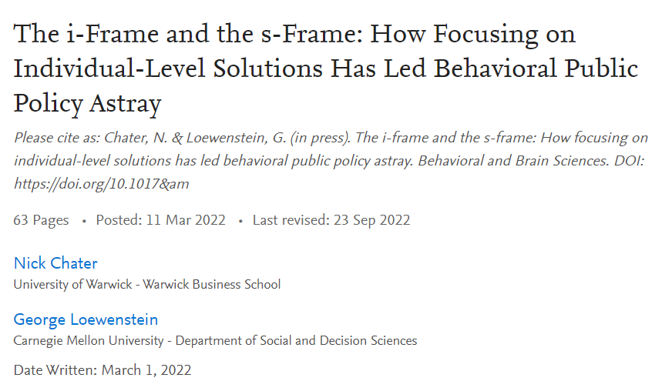
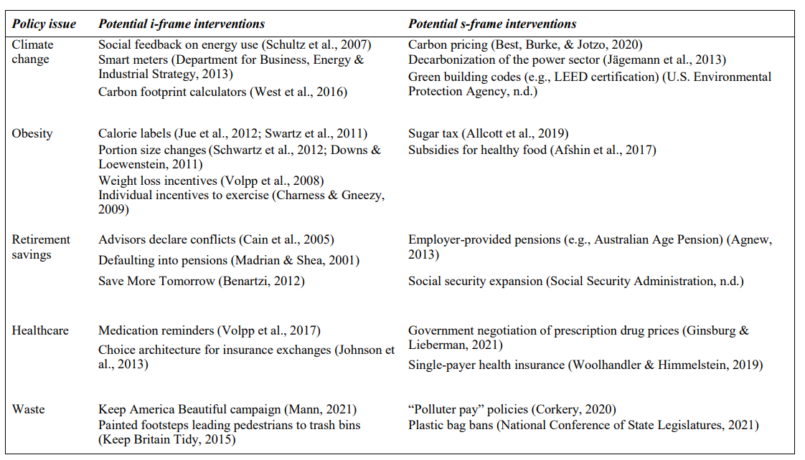
Nudges are political tools

Slide 34
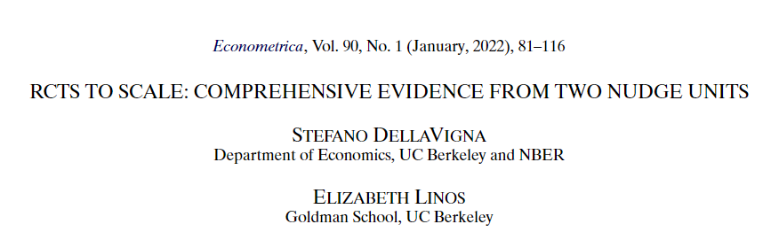
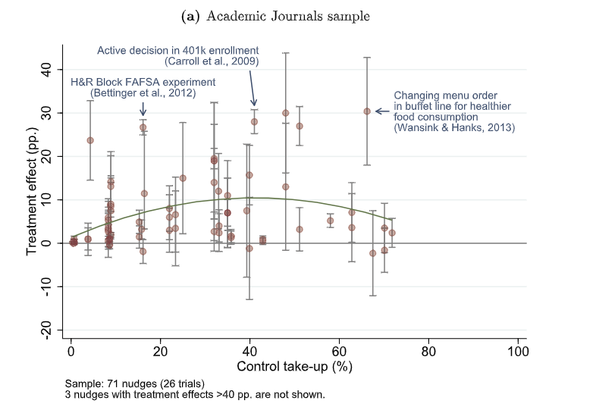
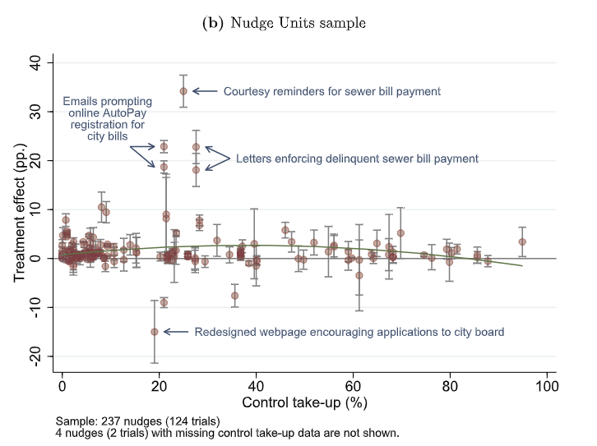
Do Nudges Work?
Notes:
Nudge interventions have quickly expanded from academic studies to larger implementation in so-called Nudge Units in governments. This provides an opportunity to compare interventions in research studies, versus at scale. We assemble a unique data set of 126 RCTs covering 23 million individuals, including all trials run by two of the largest Nudge Units in the United States. We compare these trials to a sample of nudge trials in academic journals from two recent meta-analyses. In the Academic Journals papers, the average impact of a nudge is very large—an 8.7 percentage point take-up effect, which is a 33.5% increase over the average control. In the Nudge Units sample, the average impact is still sizable and highly statistically significant, but smaller at 1.4 percentage points, an 8.1% increase. We document three dimensions which can account for the difference between these two estimates: (i) statistical power of the trials; (ii) characteristics of the interventions, such as topic area and behavioral channel; and (iii) selective publication. We estimate a meta-analysis model and find strong evidence of selective publication in academic journals. Correcting for it brings down the estimated impact of a nudge in academic journals to 3.2 percentage points, still larger than the Nudge Unit estimate, though not significantly so. Counterfactuals show that low statistical power in the Academic Journals sample exacerbates the impact of selective publication.

Slide 35
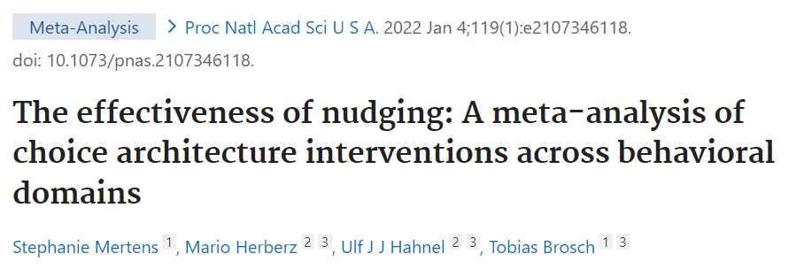
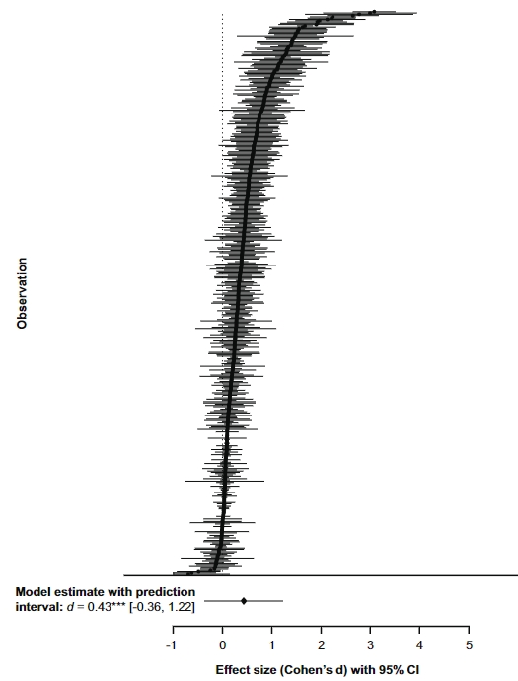
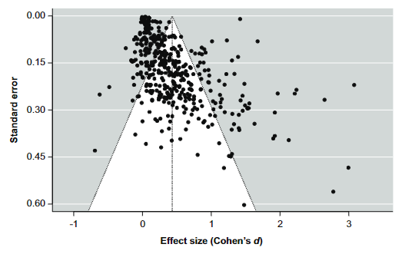
Do Nudges Work?
Drawing on more than 200 studies reporting over 450 effect sizes (n = 2,149,683) […], our results show that choice architecture interventions overall promote behavior change with a small to medium effect size of Cohen's d = 0.45 (95% CI [0.39, 0.52]).

Slide 36
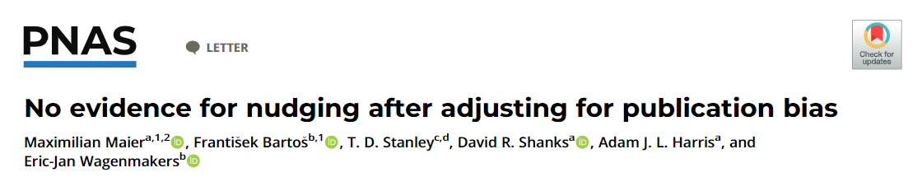
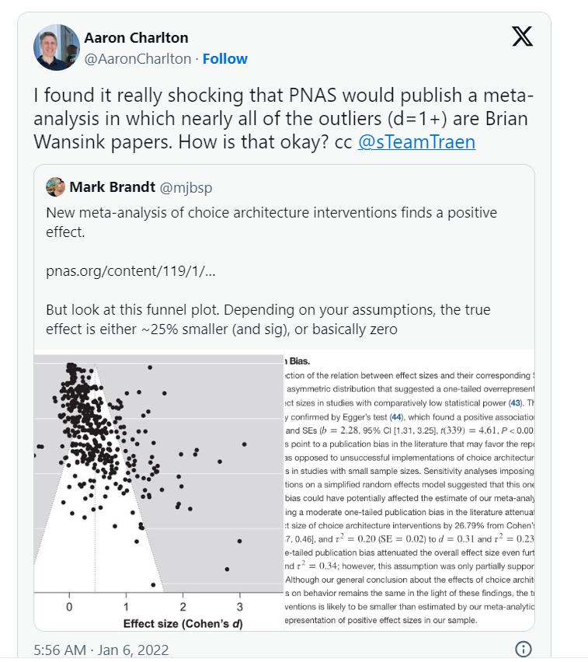
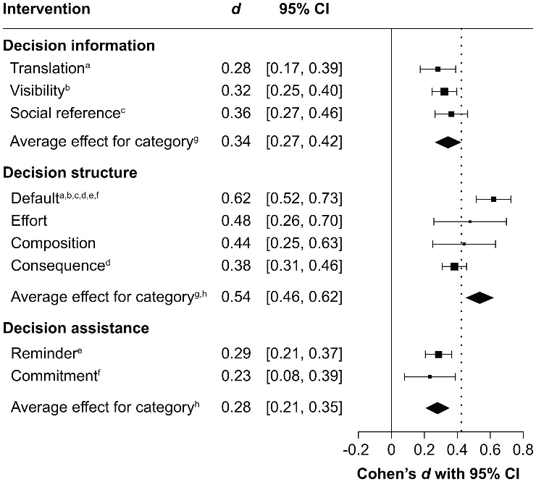
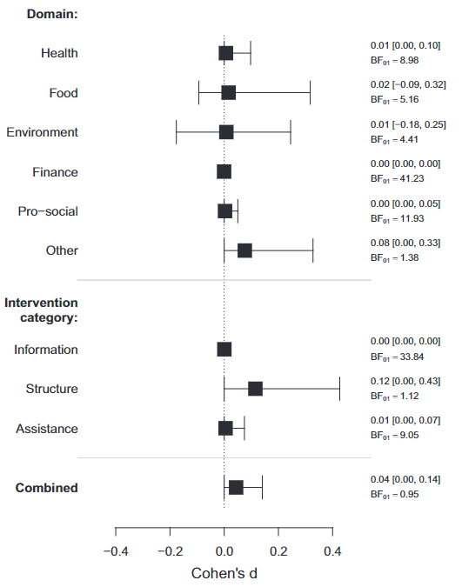

Slide 37
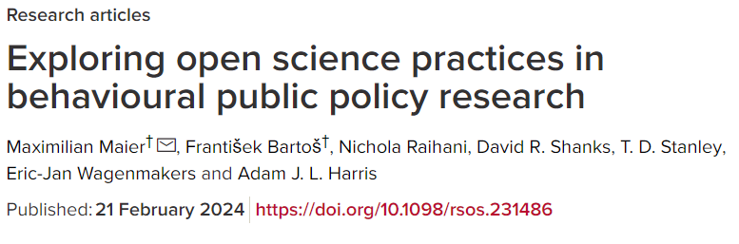
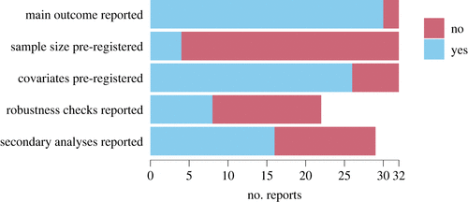
Do Nudges Work?
Pre-registration by Nudge units
Using data from DellaVigna & Linos

Slide 38
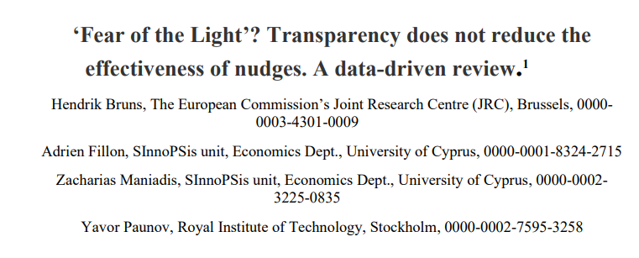
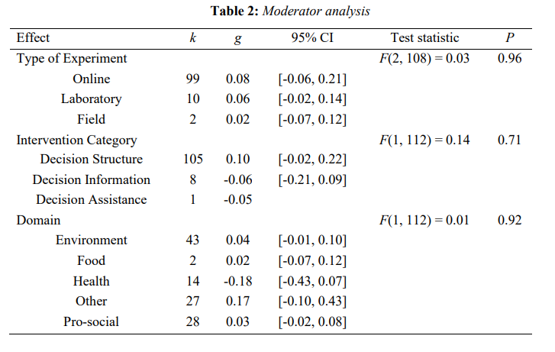
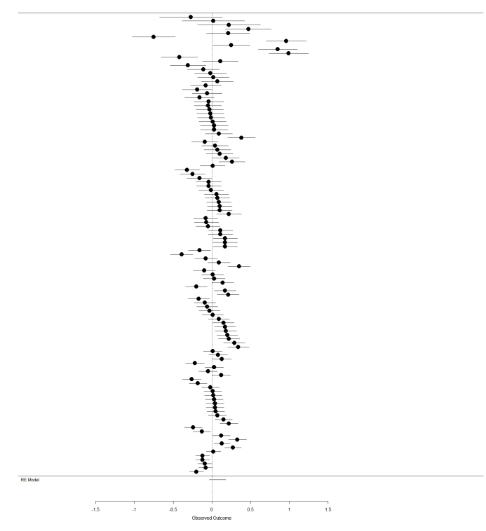
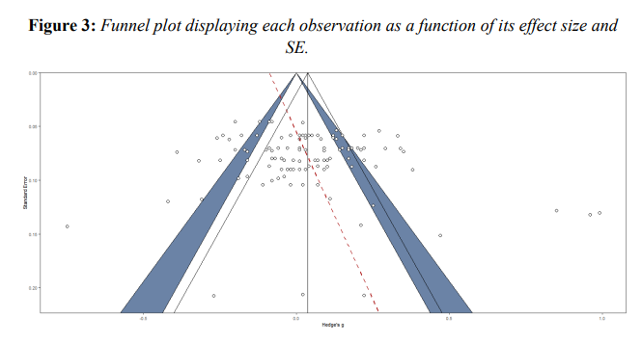

Slide 39
Do Nudges Work?
As any social sciences, Behavioral economics is plagued by false findings, questionnable practices and publication bias
It is then difficult to conclude for the effectiveness of nudges
As a meta-science group, our goal is to find ways to improve credibility in findings

Slide 40
Bias of Bias
Lack of rationality.
Experiments have shown that people’s intuitions are systematically biased.
2. Stubbornness.
Like visual illusions, biases are persistent and hardly corrigible by education.
3. Substantial costs.
Biases may incur substantial welfare-relevant costs such as lower wealth, health, or happiness.
4. Biases justify governmental paternalism.
To protect people from their biases, governments should “nudge” the public toward better behavior.

Slide 41
Bias of Bias
4. Biases justify governmental paternalism.
To protect people from their biases, governments should “nudge” the public toward better behavior.
Nudges are political decisions. They need to be embedded in systematic policies and should not serve political agenda just because they « sound » evidence-based, they have to be rigorously tested.
Instead of a paternalistic approach, some researchers are talking about Boosting, the idea to empower people to make better decisions by and for themselves.
I am not so sure about the differences between Boosting and education. At least, boosting seems more democratic.

Slide 42
Conclusion
Intuitive statistician versus bounded rationality
Experimental methods are not neutral tools
Some requires learning and feedback, others one-shoot descriptions
Reasons why Heuristics and Bias program won the heart of researchers
The bias of bias
Lack of rationality
Stubbornness
Substantial cost
Paternalism
Nudges
I-frame versus S-frame

Slide 43
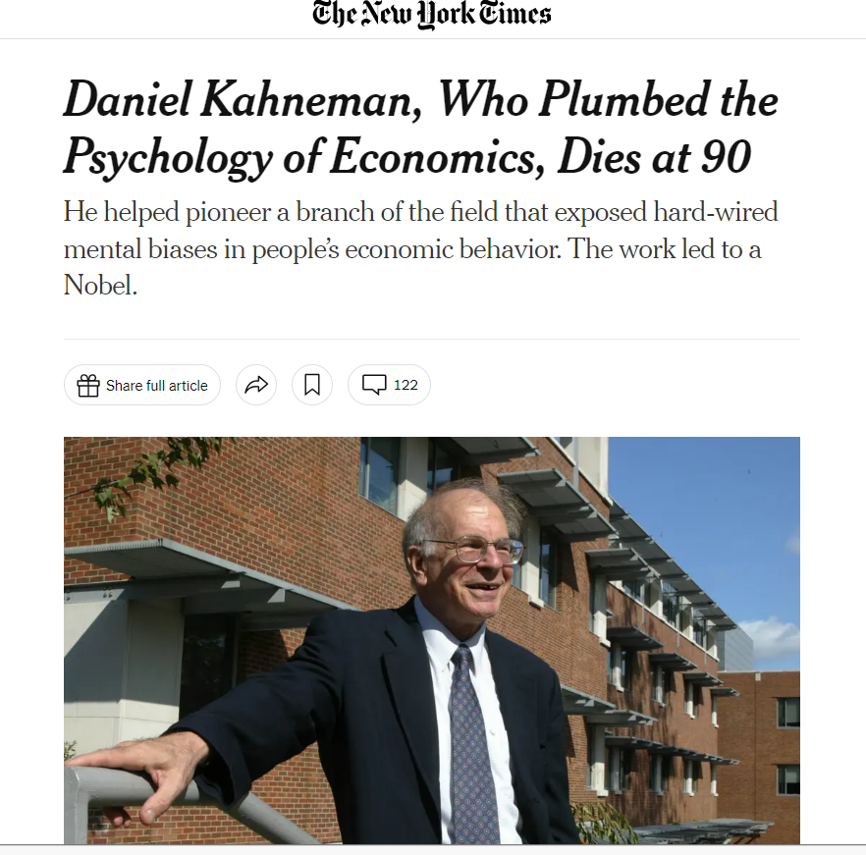
Kahneman’s last contribution
During the last 10 years, Kahneman moved away from Bias to noise
While bias is about a “average error” in judgment, noise is about variability in errors

Slide 44
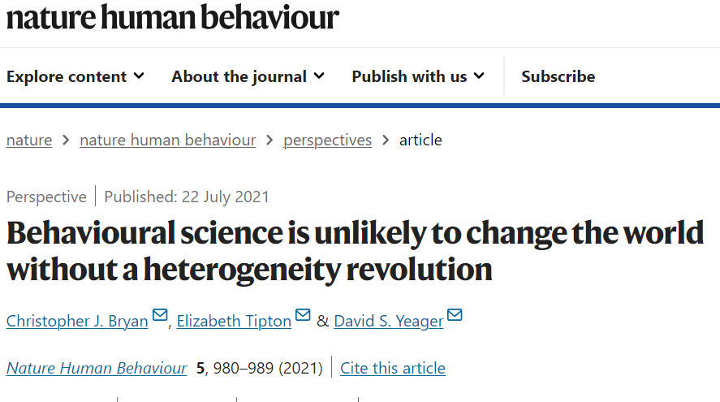
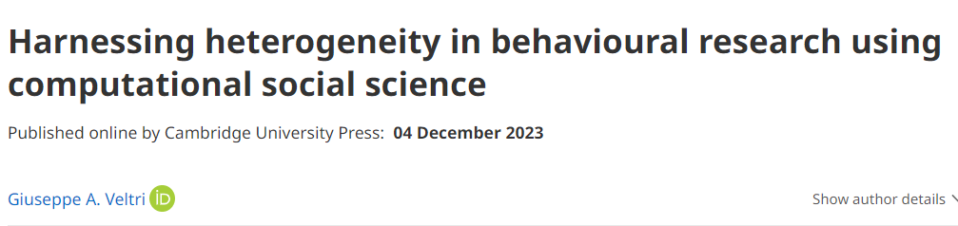
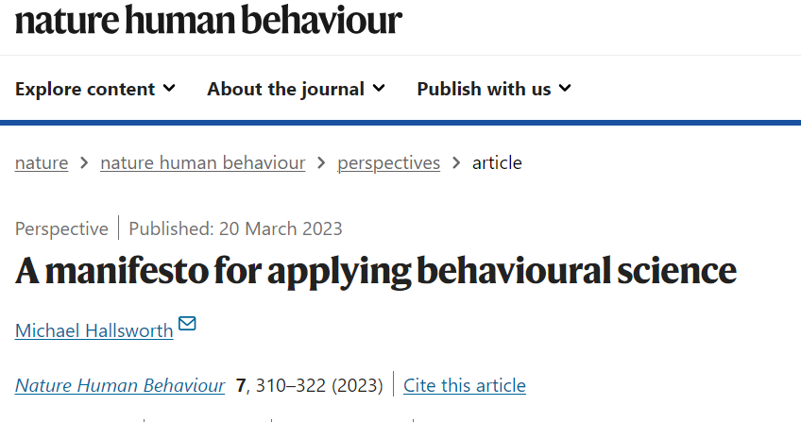
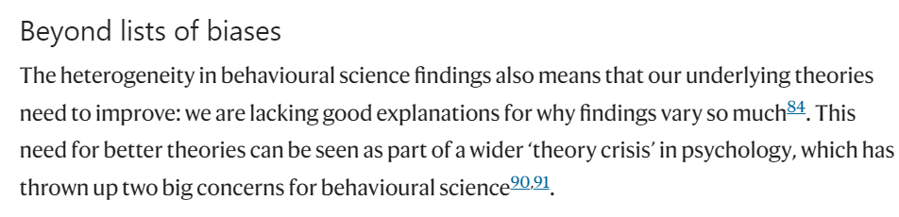

Slide 45
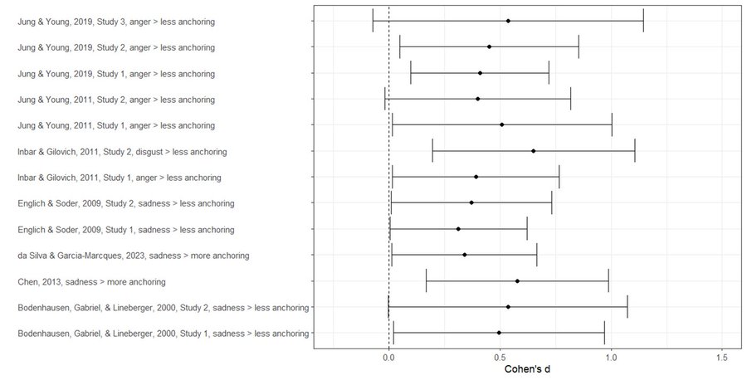

Slide 46
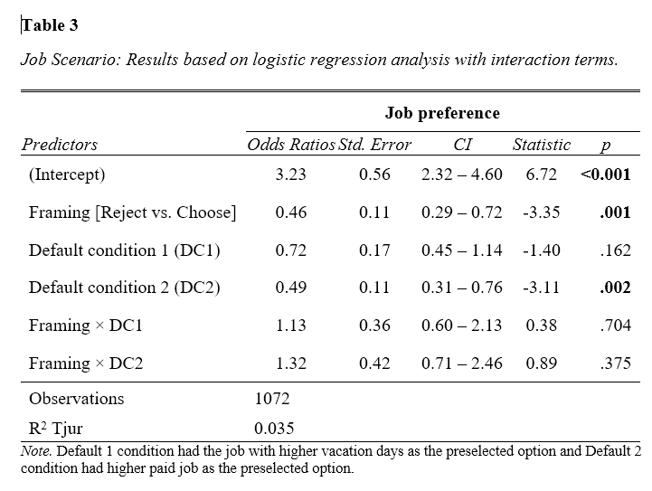
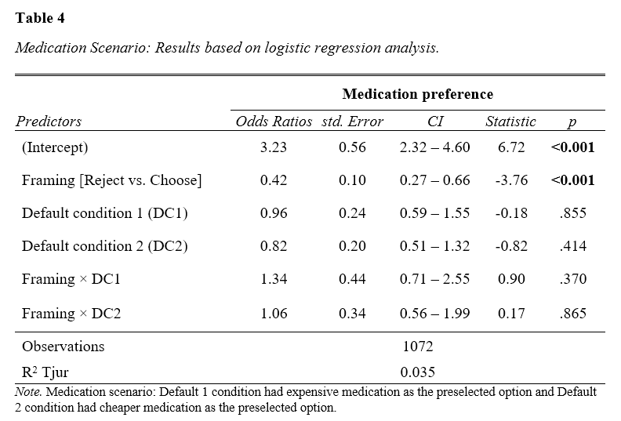
Framing the default: Influence of Choosing vs Rejecting Frame on Default Effects (Chandrashekar & Fillon, 2024)
Notes:
The Framing X default statistics is always lower than the main effect, and not significant

Slide 47
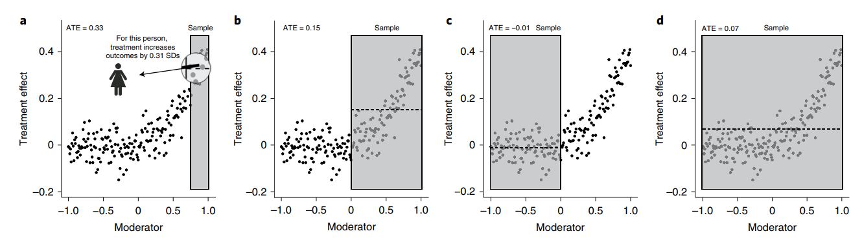
Notes:
Four hypothetical studies to estimate the same hypothesized treatment main effect (for example, the hypothesis that teaching students a growth mindset of intelligence will increase grades). Shaded regions represent the slice of the population that each hypothetical study sampled, and each dot represents the theoretical treatment effect for an individual person. The dashed line indicates the mean of the dots within the relevant shaded region, which is the average treatment effect (ATE) for each hypothetical study. a, A hypothetical study in which the sample is representative of a highly responsive segment of the population in an optimal context (for example, middle-achieving students in classrooms with norms supportive of growth mindset). b, A hypothetical study in which the sample is representative of a broader range of subpopulations and contexts, including both more and less responsive subpopulations (for example, middleand high-achieving students) and/or of a broader range of contexts, some more and some less conducive to a large treatment effect (for example, classrooms with supportive norms and ones with unsupportive norms). c, A hypothetical study in which the sample is representative of subpopulations that are not naturally responsive to the treatment and/or contexts that are nonconductive to the treatment (for example, high-achieving students in a range of classrooms and low- and medium-achieving students in classrooms with unsupportive norms). d, A hypothetical study in which the sample is representative of the full population and the relatively modest main-effect estimate masks substantial heterogeneity.

Slide 48
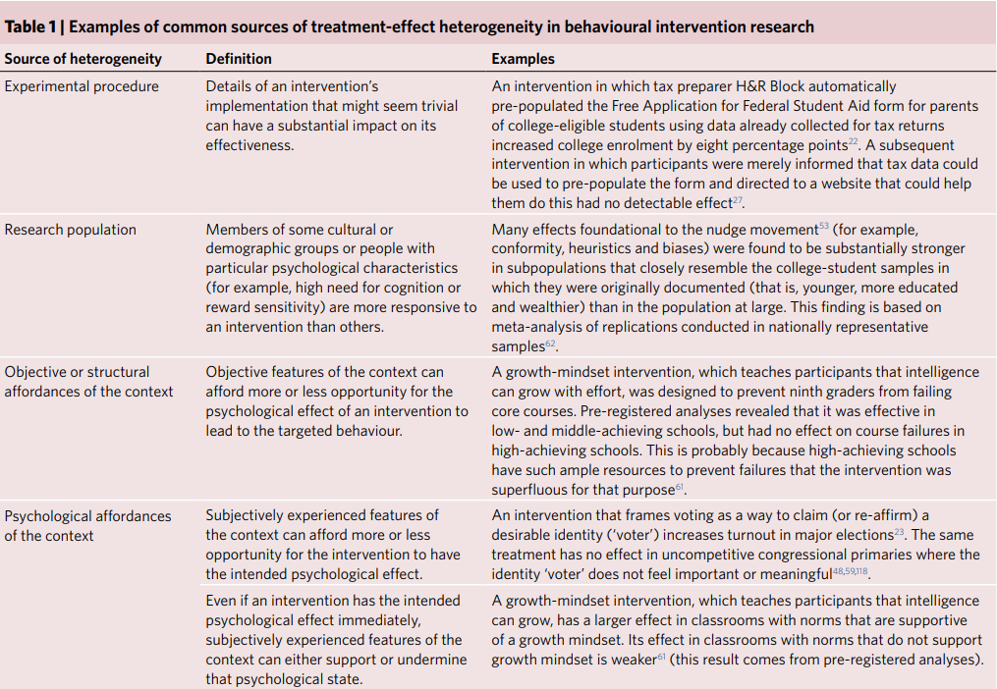

Slide 49
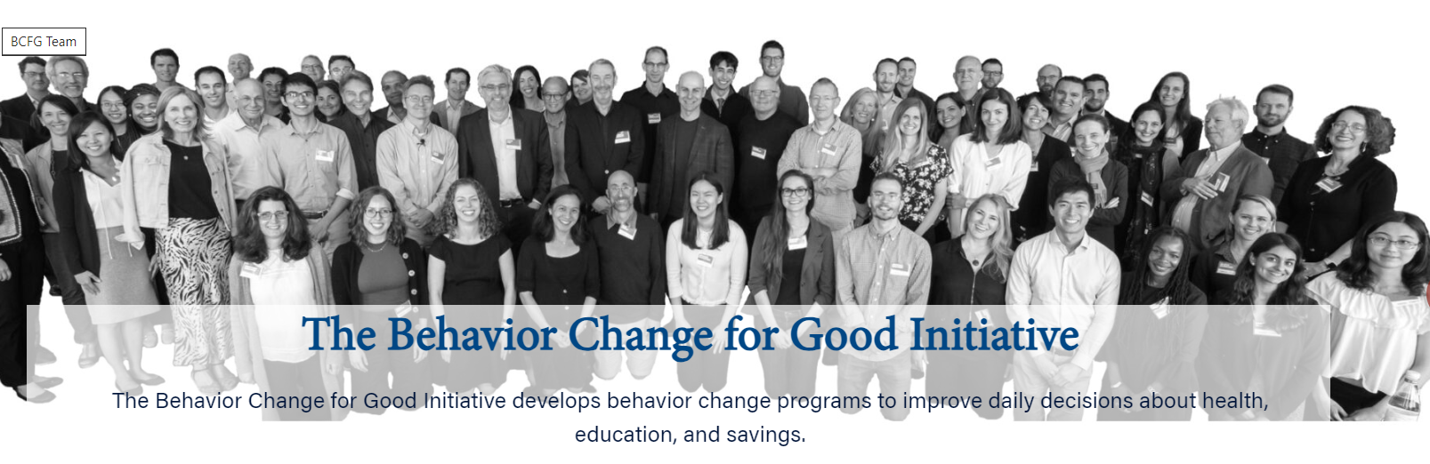


Notes:
Te Psychological Science Accelerator (PSA)119 recruits laboratories around the world to conduct the same experiments at about the same time—similar to a meta-analysis in which individual studies are coordinated and approximately simultaneous. Although the stated goal of the PSA is to understand the generalizability and heterogeneity of psychological science, it is unlikely to achieve this in its current form. It uses the same haphazard, opt-in sampling of participants (and laboratories) that has long characterized the experimental behavioural sciences. With guidance from experts in sampling and generalizability and substantial investment of resources, the PSA could provide exactly the type of infrastructure we are calling for.
Te Behavior Change for Good (BCFG) initiative (https://bcfg. wharton.upenn.edu/) facilitates ‘mega-studies’ in domains including exercise, savings and immunization by establishing temporary research relationships with private companies in relevant domains (for example, a national chain of ftness clubs). Researcher access to these opportunities is by invitation and all interventions are tested in a single, randomized trial. BCFG now also uses machine learning methods to assess which interventions are most efective for diferent subgroups of participants120. Te BCFG infrastructure is not open to outside researchers and the kinds of rich data about contexts and users that would be necessary for informative heterogeneity analyses are rarely available
e Character Lab Research Network (CLRN) (https://characterlab.org/research-network/) maintains a large, professionally managed panel of US public schools for intervention research and collects data about population and school characteristics that might moderate efects. CLRN allows investigators to pilot test their interventions, obtain qualitative feedback from relevant students, and adjust materials before launching fully powered studies. Schools are recruited with an eye toward representing the heterogeneity of contexts and students found in US public schools (that is, purposive sampling) and researchers are asked, at the proposal stage, to specify the subgroup(s) of students or schools they wish to generalize to. Teir attentiveness to heterogeneity and use of the best available non-probability sampling methods to approximate representativeness make CLRN a leading example of how infrastructure can facilitate heterogeneity-conscious research. With a substantial increase in funding, they could probably add probability sampling.

Slide 50
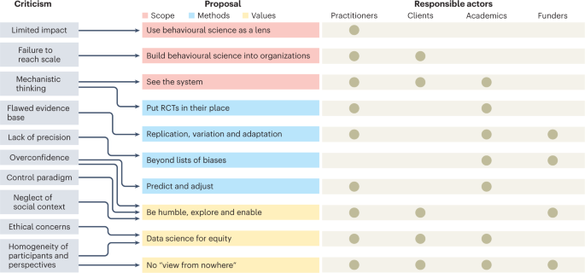

Slide 51
Concept to remember
Libertarian paternalism is the concept that researchers and policy-makers knows better than the population the correct way to behave based on behavioral economics findings, i.e., on what is an informed and rational decision (paternalism), and they can influence their behaviors whithout constraining them (libertarian).
One core concept is Nudges: modification in the choice architecture to subtly influence behaviors.
The scientific study of nudges have limitations and criticisms regarding the quality of the studies produced, the political orientation of the theory (individual versus systemic), the limited standardizations of procedures, and lack of generalizability, a high heterogeneity of the effects, but also the lack of citizens implication and autonomy.
Some researchers advocate for Boosting instead of Nudging, preserving their autonomy.
These debates are in part scientific, but also deeply politicals.

Slide 52
The end of the end

Slide 53
Behavioral Economics on decision-making
There are criticism of neoclassical theories on « what is » rationality
However, if we study decision-making based on rationality, we see that people make several errors
Only a few have been found as systematic
Most of them are noise
Because of complexity of human being
Because of context dependency
Because of the difference between experimental method used

Slide 54
Researchers need to be careful at:
1. Small sample statistics are mistaken for people’s biases.
The statistics of small samples can systematically differ from the population parameters. If researchers ignore this difference, they will mistake correct judgments about small samples for systematic biases.
2. Unsystematic errors are mistaken for systematic biases.
A bias is a systematic error, not an unsystematic one.
3. Logically equivalent frames are mistaken as informationally equivalent.
To pay attention to how a message is framed is not a logical error but an essential feature of human intelligence.

Slide 55
Conclusion
We came from « we are all victims of our biases because we are irrational »,
To « we have developed a theory of rationality and irrationality and are trying to figure out how , and how well this theory applies in real-life situations ».
Are we intuitive statisticians or irrational beings? It depends on the choice, the context of the choice and the way we measure it.

Slide 56
References 1/2
Bryan, C. J., Tipton, E., & Yeager, D. S. (2021). Behavioural science is unlikely to change the world without a heterogeneity revolution. Nature human behaviour, 5(8), 980-989.
Chandrashekar, S., Cheng‎, Y. H., Fong‎, C. L., Leung‎, Y. C., Wong, Y. T., Cheng, B. L., & Feldman, G. (2021). Frequency estimation and semantic ambiguity do not eliminate ‎conjunction bias, when it ‎occurs: Replication and extension of ‎Mellers, Hertwig, and Kahneman (2001)‎. In Meta-Psychology (Vol. 5). Linnaeus University. https://doi.org/10.15626/mp.2020.2474
Chater, N., & Loewenstein, G. F. (2022). The i-Frame and the s-Frame: How Focusing on the Individual-Level Solutions Has Led Behavioral Public Policy Astray. In SSRN Electronic Journal. Elsevier BV. https://doi.org/10.2139/ssrn.4046264
DellaVigna, S., & Linos, E. (2022). RCTs to scale: Comprehensive evidence from two nudge units. Econometrica, 90(1), 81-116.
Gigerenzer, G. (2018). The Bias Bias in Behavioral Economics. In Review of Behavioral Economics (Vol. 5, Issues 3–4, pp. 303–336). Now Publishers. https://doi.org/10.1561/105.00000092
Hallsworth, M. (2023). A manifesto for applying behavioural science. Nature Human Behaviour, 7(3), 310-322.
Lejarraga, T., & Hertwig, R. (2021). How experimental methods shaped views on human competence and rationality. In Psychological Bulletin (Vol. 147, Issue 6, pp. 535–564). American Psychological Association (APA). https://doi.org/10.1037/bul0000324
Maier, M., Bartoš, F., Stanley, T. D., Shanks, D. R., Harris, A. J., & Wagenmakers, E. J. (2022). No evidence for nudging after adjusting for publication bias. Proceedings of the National Academy of Sciences, 119(31), e2200300119.

Slide 57
References 2/2
Maier, M., Bartoš, F., Raihani, N., Shanks, D. R., Stanley, T. D., Wagenmakers, E. J., & Harris, A. J. (2024). Exploring open science practices in behavioural public policy research. Royal Society Open Science, 11(2), 231486.
Mertens, S., Herberz, M., Hahnel, U. J., & Brosch, T. (2022). The effectiveness of nudging: A meta-analysis of choice architecture interventions across behavioral domains. Proceedings of the National Academy of Sciences, 119(1), e2107346118.
Ruggeri, K., Ashcroft-Jones, S., Abate Romero Landini, G., Al-Zahli, N., Alexander, N., Andersen, M. H., Bibilouri, K., Busch, K., Chen, J., Doubravová, B., Dugue, T., DURRANI, A., Dutra, N., Garcia-Garzon, E., Gomes, C., Gracheva, A., Grilc, N., Gurol, D. M., Heidenry, Z., … Stock, F. (2022). Poor but not by choice(s): The persistence of cognitive biases across economic groups. Center for Open Science. https://doi.org/10.31234/osf.io/mrxy6
Simon, H. A. 1979. “Information processing models of cognition”. Annual Review of Psychology. 30: 363–396.
Simon, H. A. 1989. “The scientist as problem solver”. In: Complex information processing: The impact of Herbert A. Simon. Ed. by D. Klahr and K. Kotovsky. Hillsdale, NJ: Erlbaum. 375–398.
Veltri, G. A. (2023). Harnessing heterogeneity in behavioural research using computational social science. Behavioural Public Policy, 1-18.

